Slide 1
Magenic Masters React Elective
Jan 26, 2017

Slide 2
What You’ll Learn
Best Practices in React JS

Slide 3
How do we measure code quality?

Slide 4
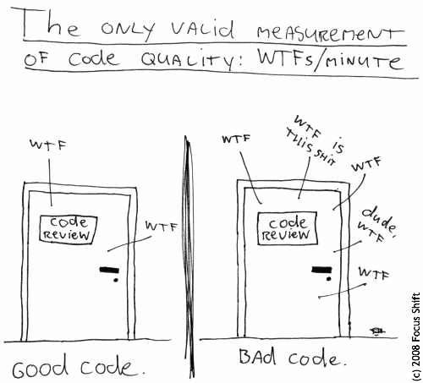
Code Quality
According to Clean Code

Slide 5
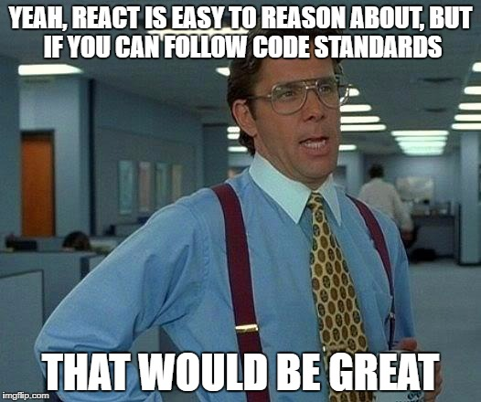
React Components

Slide 6
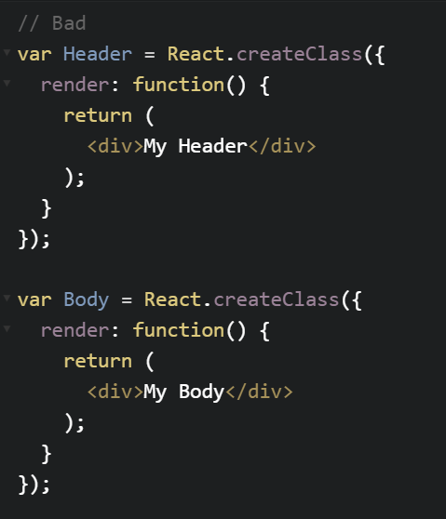
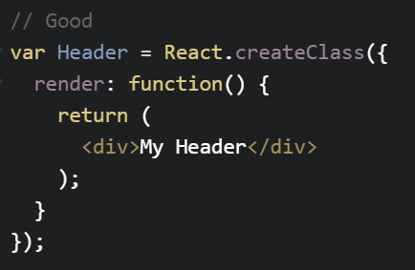
Components
Only include one React component per file

Slide 7

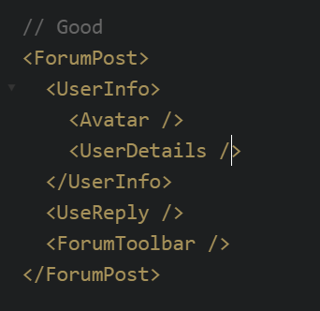
Components
Your component should only do one thing and it should do it very well

Slide 8
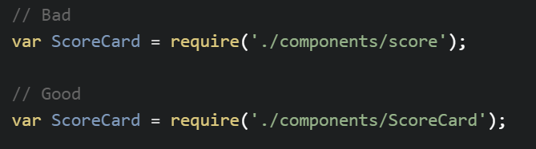
Naming
Use .jsx extension for React components
Use PascalCase for filenames, ex. Timer.jsx
Use filename as component name

Slide 9
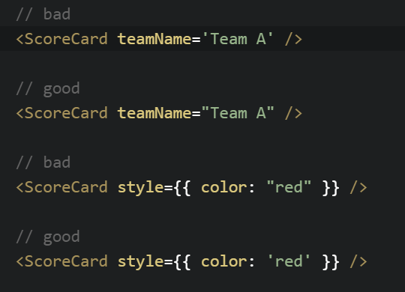
Quotes
Always use double quotes (") for JSX attributes, but single quotes (') for all other JS
Why? Regular HTML attributes also typically use double quotes instead of single, so JSX attributes mirror this convention.

Slide 10
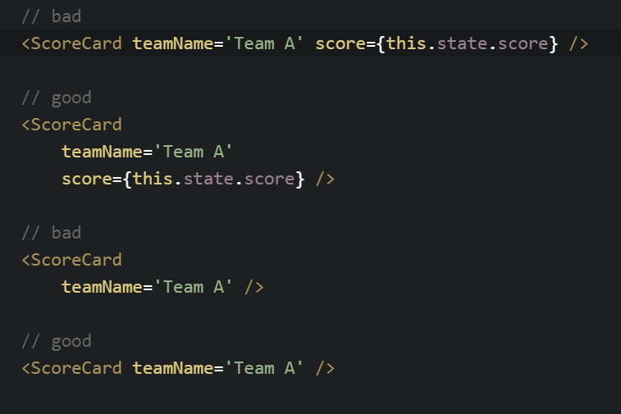
Alignment
Follow these alignment styles for JSX syntax

Slide 11
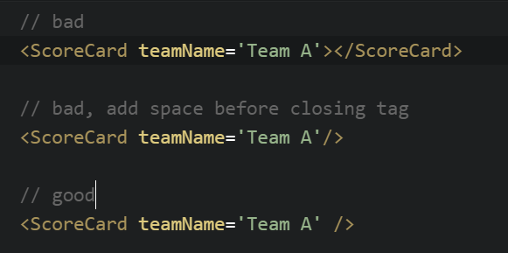
Tags
Always self-close tags that have no children

Slide 12
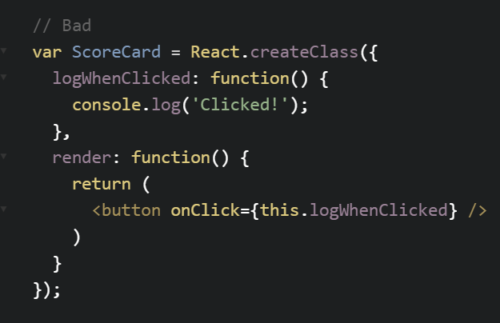
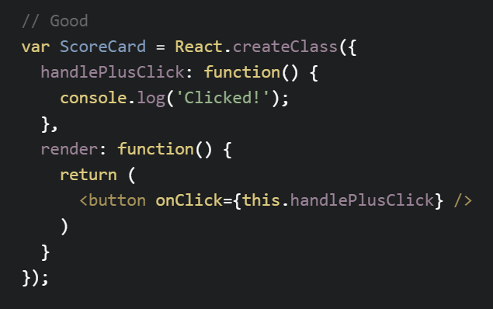
Event Tags and Handler
Name handlers, handle<Function>EventName

Slide 13
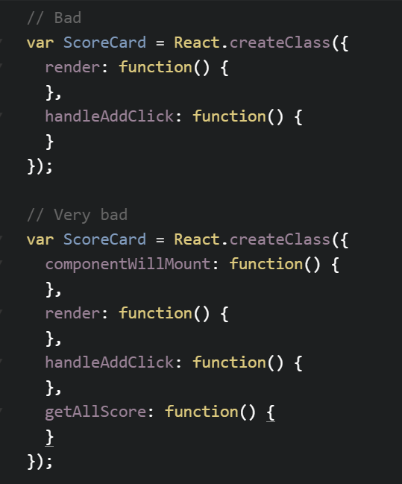
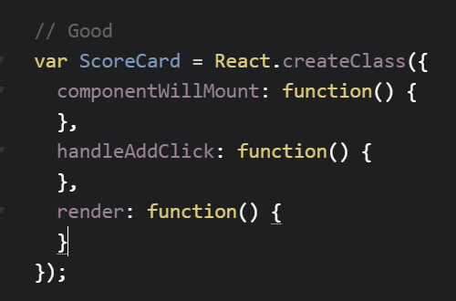
Render Function
The render method should always be last

Slide 14
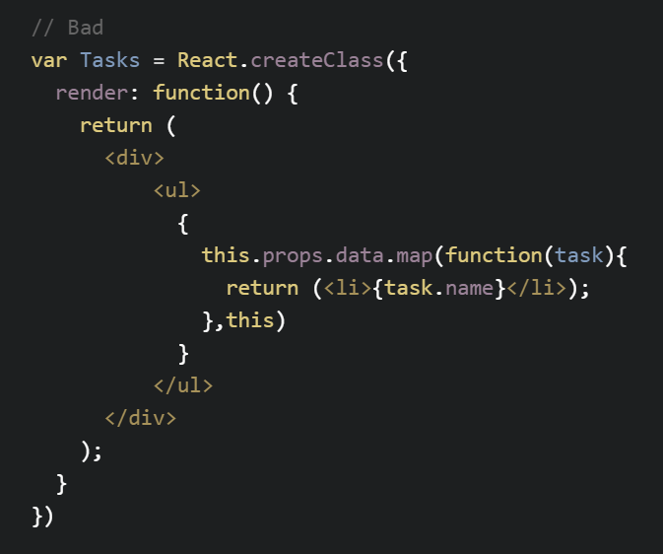
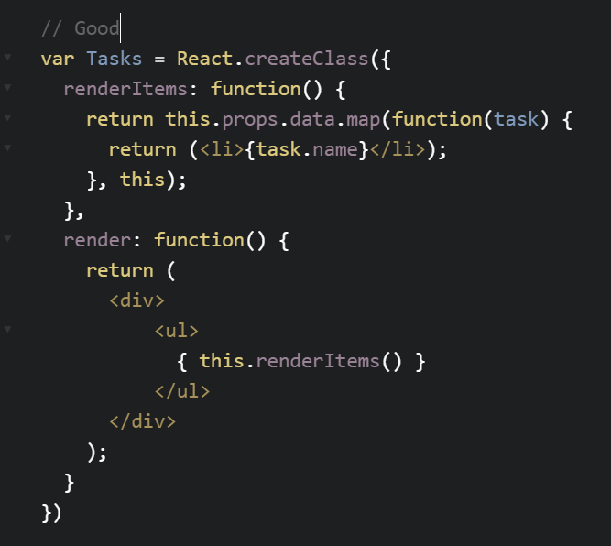
Render Function
If the map function is too long or complicated, extract it out into its own method on the component class.

Slide 15
Component Functions
Within your react component, order your methods like:
1. Lifecycle methods (in chronological order):
getDefaultProps,
getInitialState,
componentWillMount,
componentDidMount,
componentWillReceiveProps,
shouldComponentUpdate,
componentWillUpdate,
componentDidUpdate,
componentWillUnmount
2. Everything else
3. Render

Slide 16
jQuery
In general, avoid using jQuery within React components
Never use jQuery in a component for DOM manipulation
Performing ajax with jQuery in your component is fine
If you're using a jQuery plugin, consider encapsulating the use of the plugin in its own component so that you only have to manage it in a single place

